Slide 1



Arduino 6 – accelerometer
Steven hammer
s.hammer@hw.ac.uk

Slide 2
introduction
Use an Arduino with an accelerometer to measure acceleration

Slide 3
What are we doing today?
Build the accelerometer circuit
Install accelerometer libraries to the Arduino IDE
Measure acceleration and orientation using the Adafruit MMA8451 accelerometer
Estimate velocity and displacement using acceleration

Slide 4
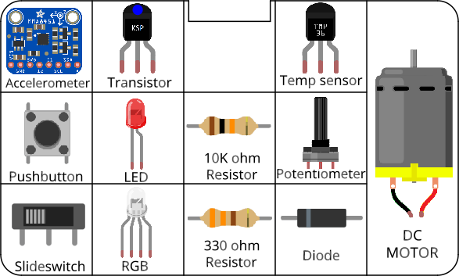
Circuits
All components included in the kit…

Slide 5
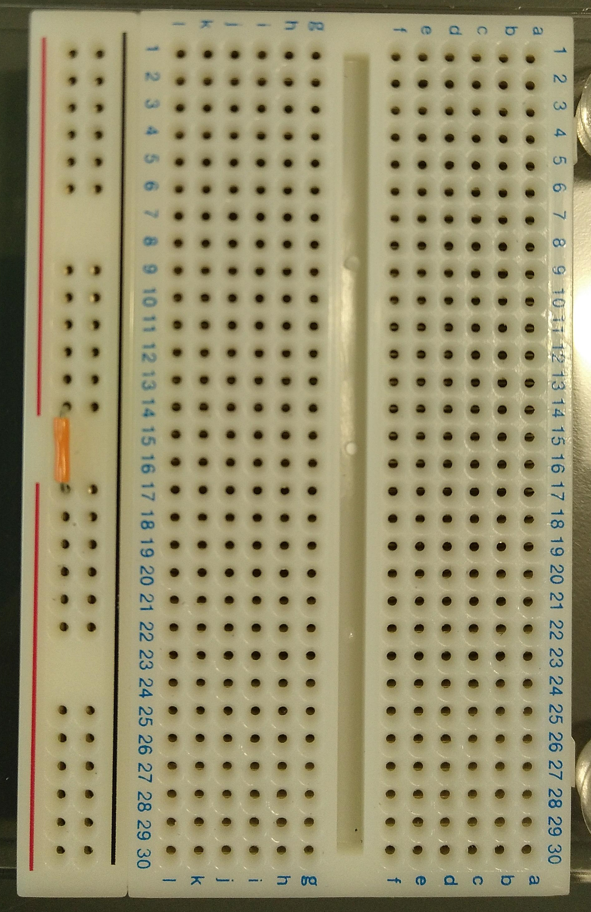
Before you start Building circuits…
Connect power bus (+ line) together using a small section of jumper cable

Slide 6
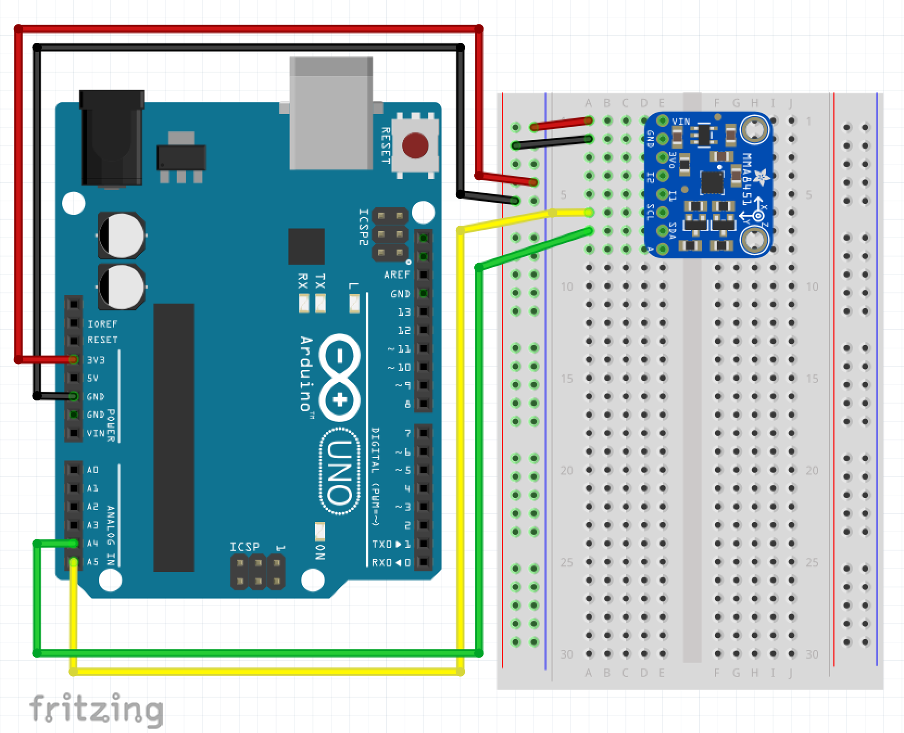
Building circuits
Insert components into breadboard holes
Connect up using instrument wire
Arduino controls inputs and outputs
Follow schematics
NOTE: GND = negative

Slide 7
Debugging code
Is there a space missing somewhere?
Do all lines end with a semicolon;
Is something commented out //

Slide 8
housekeeping
Take two boxes:
One Arduino box
One Sensors and Motion kit
Put components back into labelled places in boxes after use
Any components missing – let us know.

Slide 9
TIDYING up
Return components to your Sensors and Motion box IN THE CORRECT PLACES!!!
Put instrument wire in motor compartment
Return Arduino to its case
Return both boxes to tutor

Slide 10
Finished already?
Estimated displacement and velocity are going to be wrong…see if you can work out why.
Create a damage warning trigger – if a sudden acceleration is detected, light a warning LED.

